Slide 1

CSE 3121
Database Management Systems
Session: 2016-17
Dr. Asif Zaman
Associate Professor, CSE, RU
Week # 1

Slide 2
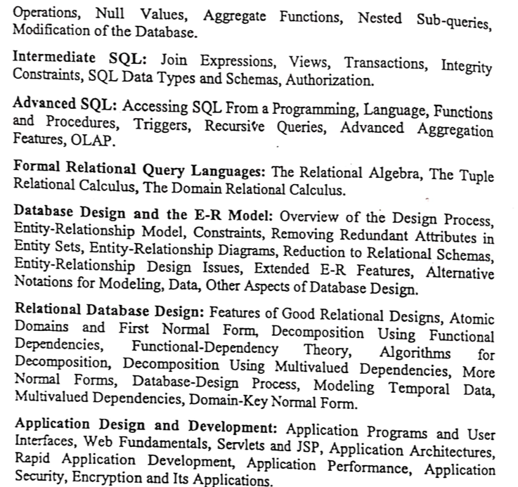
Course Contents

Slide 3


Slide 4
Overview of the Design Process
Initial phase -- characterize fully the data needs of the prospective database users.
Second phase -- choosing a data model
Applying the concepts of the chosen data model
Translating these requirements into a conceptual schema of the database.
A fully developed conceptual schema indicates the functional requirements of the enterprise.
Describe the kinds of operations (or transactions) that will be performed on the data.

Slide 5
Overview of the Design Process
Final Phase -- Moving from an abstract data model to the implementation of the database
Logical Design – Deciding on the database schema. Database design requires that we find a “good” collection of relation schemas.
Business decision – What attributes should we record in the database?
Computer Science decision – What relation schemas should we have and how should the attributes be distributed among the various relation schemas?
Physical Design – Deciding on the physical layout of the database
Notes:
5

Slide 6
Design Alternatives
In designing a database schema, we must ensure that we avoid two major pitfalls:
Redundancy: a bad design may result in repeat information.
Redundant representation of information may lead to data inconsistency among the various copies of information
Incompleteness: a bad design may make certain aspects of the enterprise difficult or impossible to model.
Avoiding bad designs is not enough. There may be a large number of good designs from which we must choose.
Notes:
6

Slide 7
Design Approaches
Entity Relationship Model
Models an enterprise as a collection of entities and relationships
Entity: a “thing” or “object” in the enterprise that is distinguishable from other objects
Described by a set of attributes
Relationship: an association among several entities
Represented diagrammatically by an entity-relationship diagram:
Normalization Theory
Formalize what designs are bad, and test for them
Notes:
7

Slide 8
Outline of the ER Model

Slide 9
ER model -- Database Modeling
The ER data mode was developed to…. represents the overall logical structure of a database.
The ER data model employs three basic concepts:
entity sets,
relationship sets,
attributes.
The ER model also has an associated diagrammatic representation, the ER diagram, which can express the overall logical structure of a database graphically.

Slide 10
Entity Sets
An Entity is an object that exists and is distinguishable from other objects.
Example: specific person, company, event, plant
An Entity Set is a set of entities of the same type that share the same properties.
Example: set of all persons, companies, trees, holidays

Slide 11
Entity Sets
An entity is represented by a set of attributes; i.e., descriptive properties possessed by all members of an entity set.
Example:
instructor = (ID, name, salary ) course= (course_id, title, credits)
A subset of the attributes form a primary key of the entity set; i.e., uniquely identifying each member of the set.

Slide 12
Entity Sets -- instructor and student

Slide 13

Representing Entity sets in ER Diagram
Entity sets can be represented graphically as follows:
Rectangles represent entity sets.
Attributes listed inside entity rectangle
Underline indicates primary key attributes

Slide 14
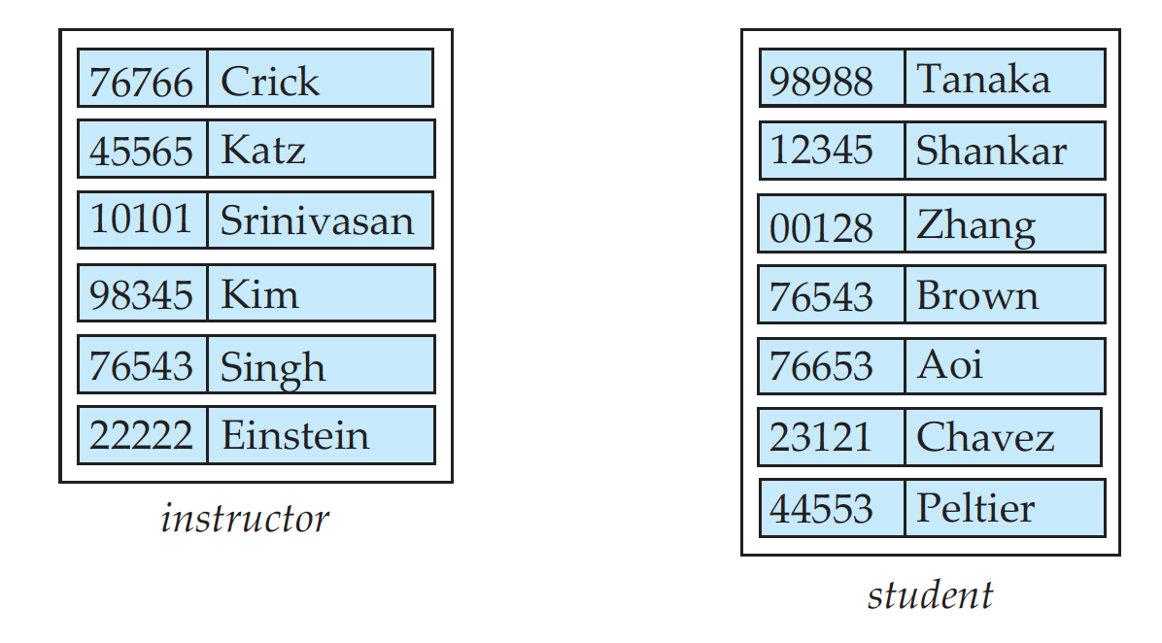
Relationship Sets
A relationship is an association among several entities
Example: 44553 (Peltier) advisor 22222 (Einstein) student entity relationship set instructor entity
A relationship set is a mathematical relation among n ≥ 2 entities, each taken from entity sets
{(e₁, e₂, … e_{n}) | e₁ ∈ E₁, e₂ ∈ E₂, …, e_{n} ∈ E_{n}} where (e₁, e₂, …, e_{n}) is a relationship
Example:
(44553,22222) ∈ advisor

Slide 15
Relationship Sets (Cont.)
Example: we define the relationship set advisor to denote the associations between students and the instructors who act as their advisors.
Pictorially, we draw a line between related entities.

Slide 16
Relationship Sets ER Diagrams
Diamonds represent relationship sets.

Slide 17
Relationship Sets (Cont.)
An attribute can also be associated with a relationship set.
For instance, the advisor relationship set between entity sets instructor and student may have the attribute date which tracks when the student started being associated with the advisor

Slide 18
Relationship Sets with Attributes

Slide 19
Roles
Entity sets of a relationship need not be distinct
Each occurrence of an entity set plays a “role” in the relationship
The labels “course_id” and “prereq_id” are called roles.

Slide 20
Degree of a Relationship Set
Binary relationship
involve two entity sets (or degree two).
most relationship sets in a database system are binary.
Relationships between more than two entity sets are rare. Most relationships are binary.
Example: students work on research projects under the guidance of an instructor.
relationship proj_guide is a ternary relationship between instructor, student, and project

Slide 21
Non-binary Relationship Sets
Most relationship sets are binary
There are occasions when it is more convenient to represent relationships as non-binary.
E-R Diagram with a Ternary Relationship

Slide 22
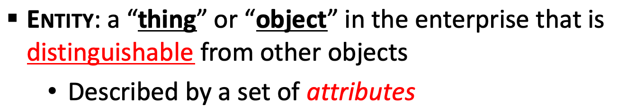
Complex Attributes
Attribute types:
Simple and composite attributes.
Single-valued and multivalued attributes
Example: multivalued attribute: phone_numbers
Derived attributes
Can be computed from other attributes
Example: age, given date_of_birth
Domain – the set of permitted values for each attribute

Slide 23
Composite Attributes
Composite attributes allow us to divided attributes into subparts (other attributes).

Slide 24
Representing Complex Attributes in ER Diagram

Slide 25
Mapping Cardinality Constraints
Express the number of entities to which another entity can be associated via a relationship set.
Most useful in describing binary relationship sets.
For a binary relationship set the mapping cardinality must be one of the following types:
One to one
One to many
Many to one
Many to many

Slide 26
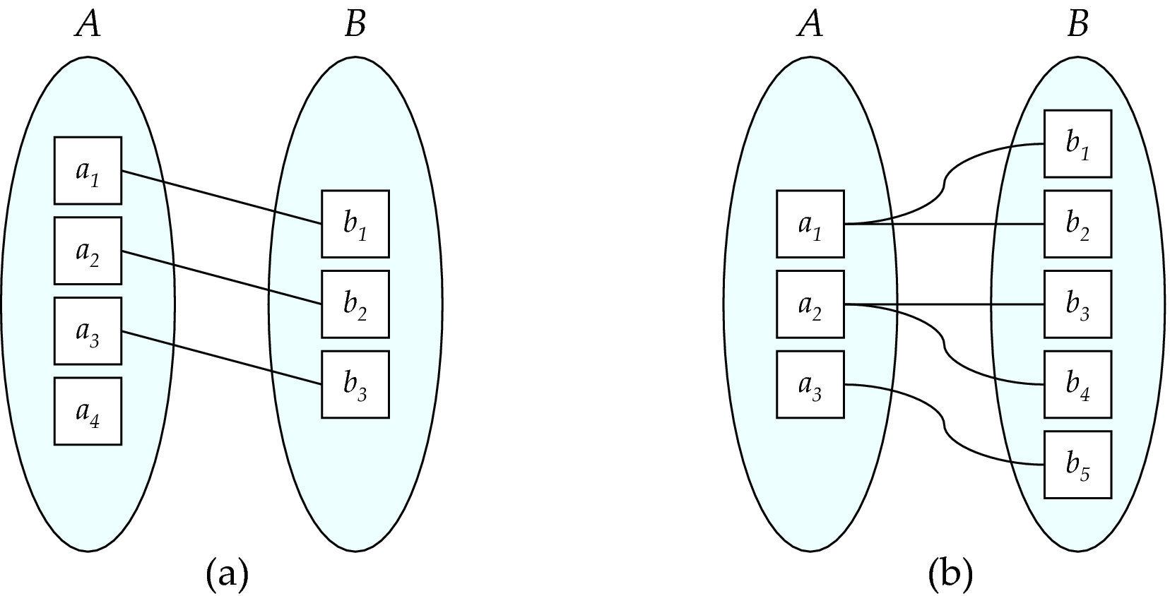
Mapping Cardinalities
One to one
One to many
Note: Some elements in A and B may not be mapped to any elements in the other set

Slide 27
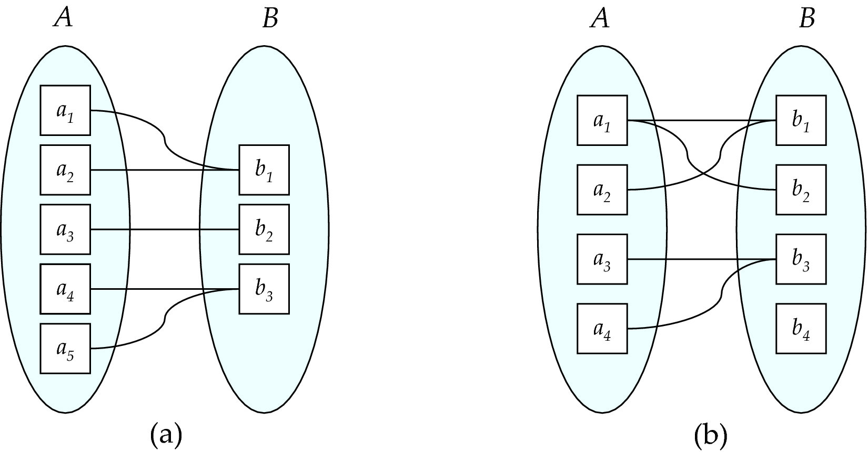
Mapping Cardinalities
Many to one
Many to many
Note: Some elements in A and B may not be mapped to any
elements in the other set

Slide 28
Cardinality Constraints in ER Diagram
We express cardinality constraints by drawing either a directed line (→), signifying “one,” or an undirected line (—), signifying “many,” between the relationship set and the entity set.
A student is associated with at most one instructor via the relationship advisor
A student is associated with at most one department via stud_dept

Slide 29
One-to-Many Relationship
one-to-many relationship between an instructor and a student
an instructor is associated with several (including 0) students via advisor
a student is associated with at most one instructor via advisor,

Slide 30
Many-to-One Relationships
In a many-to-one relationship between an instructor and a student,
an instructor is associated with at most one student via advisor,
and a student is associated with several (including 0) instructors via advisor

Slide 31
Many-to-Many Relationship
An instructor is associated with several (possibly 0) students via advisor
A student is associated with several (possibly 0) instructors via advisor

Slide 32
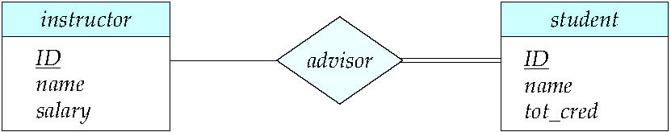
Total and Partial Participation
Total participation (indicated by double line): every entity in the entity set participates in at least one relationship in the relationship set
participation of student in advisor relation is total
every student must have an associated instructor
Partial participation: some entities may not participate in any relationship in the relationship set
Example: participation of instructor in advisor is partial

Slide 33
Primary Key
Primary keys provide a way to specify how entities and relations are distinguished. We will consider:
Entity sets
Relationship sets.
Weak entity sets

Slide 34
Primary key for Entity Sets
By definition, individual entities are distinct.
From database perspective, the differences among them must be expressed in terms of their attributes.
The values of the attribute values of an entity must be such that they can uniquely identify the entity.
No two entities in an entity set are allowed to have exactly the same value for all attributes.
A key for an entity is a set of attributes that suffice to distinguish entities from each other

Slide 35
Primary Key for Relationship Sets
To distinguish among the various relationships of a relationship set we use the individual primary keys of the entities in the relationship set.
Let R be a relationship set involving entity sets E1, E2, .. En
The primary key for R is consists of the union of the primary keys of entity sets E1, E2, ..En

Slide 36
Primary Key for Relationship Sets
If the relationship set R has attributes a1, a2, .., am associated with it, then the primary key of R also includes the attributes a1, a2, .., am
Example: relationship set “advisor”.
The primary key consists of inrsructor.ID and student.ID
The choice of the primary key for a relationship set depends on the mapping cardinality of the relationship set.

Slide 37
Choice of Primary key for Binary Relationship
Many-to-Many relationships. The preceding union of the primary keys is a minimal superkey and is chosen as the primary key.
One-to-Many relationships . The primary key of the “Many” side is a minimal superkey and is used as the primary key.
Many-to-one relationships. The primary key of the “Many” side is a minimal superkey and is used as the primary key.
One-to-one relationships. The primary key of either one of the participating entity sets forms a minimal superkey, and either one can be chosen as the primary key.

Slide 38


Weak Entity Sets
Consider a section entity, which is uniquely identified by a course_id, semester, year, and sec_id.
Clearly, section entities are related to course entities. Suppose we create a relationship set sec_course between entity sets section and course.
Note that the information in sec_course is redundant, since section already has an attribute course_id, which identifies the course with which the section is related.
One option to deal with this redundancy is to get rid of the relationship sec_course; however, by doing so the relationship between section and course becomes implicit in an attribute, which is not desirable.

Slide 39
Weak Entity Sets (Cont.)
An alternative way to deal with this redundancy is to not store the attribute course_id in the section entity and to only store the remaining attributes section_id, year, and semester.
However, the entity set section then does not have enough attributes to identify a particular section entity uniquely
To deal with this problem, we treat the relationship sec_course as a special relationship that provides extra information, in this case, the course_id, required to identify section entities uniquely.

Slide 40
Weak Entity Sets (Cont.)
A weak entity set is one whose existence is dependent on another entity, called its identifying entity
Instead of associating a primary key with a weak entity, we use the identifying entity, along with extra attributes called discriminator to uniquely identify a weak entity.

Slide 41
Weak Entity Sets (Cont.)
An entity set that is not a weak entity set is termed a strong entity set.
Every weak entity must be associated with an identifying entity; that is, the weak entity set is said to be existence dependent on the identifying entity set.

Slide 42
Weak Entity Sets (Cont.)
The identifying entity set is said to own the weak entity set that it identifies.
The relationship associating the weak entity set with the identifying entity set is called the identifying relationship.
Note that the relational schema we eventually create from the entity set section does have the attribute course_id, for reasons that will become clear later, even though we have dropped the attribute course_id from the entity set section.

Slide 43
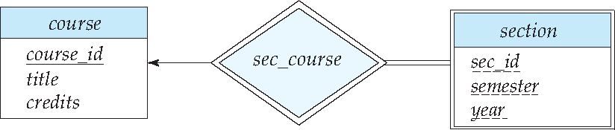
Expressing Weak Entity Sets
In E-R diagrams, a weak entity set is depicted via a double rectangle.
We underline the discriminator of a weak entity set with a dashed line.
The relationship set connecting the weak entity set to the identifying strong entity set is depicted by a double diamond.
Primary key for section – (course_id, sec_id, semester, year)

Slide 44
Redundant Attributes
Suppose we have entity sets:
instructor, with attributes: ID, name, dept_name, salary
department, with attributes: dept_name, building, budget
We model the fact that each instructor has an associated department using a relationship set inst_dept
The attribute dept_name in instructor replicates information present in the relationship and is therefore redundant
and needs to be removed.
BUT: when converting back to tables, in some cases the attribute gets reintroduced, as we will see later.
instructor
ID
name
dept_name
salary
department
dept_name
building
budget
inst_dept

Slide 45
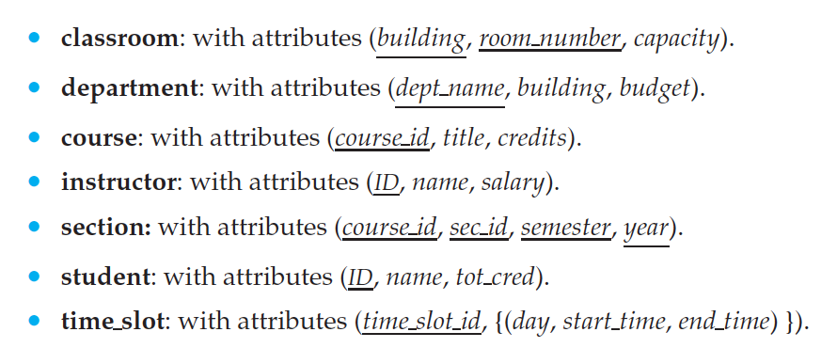
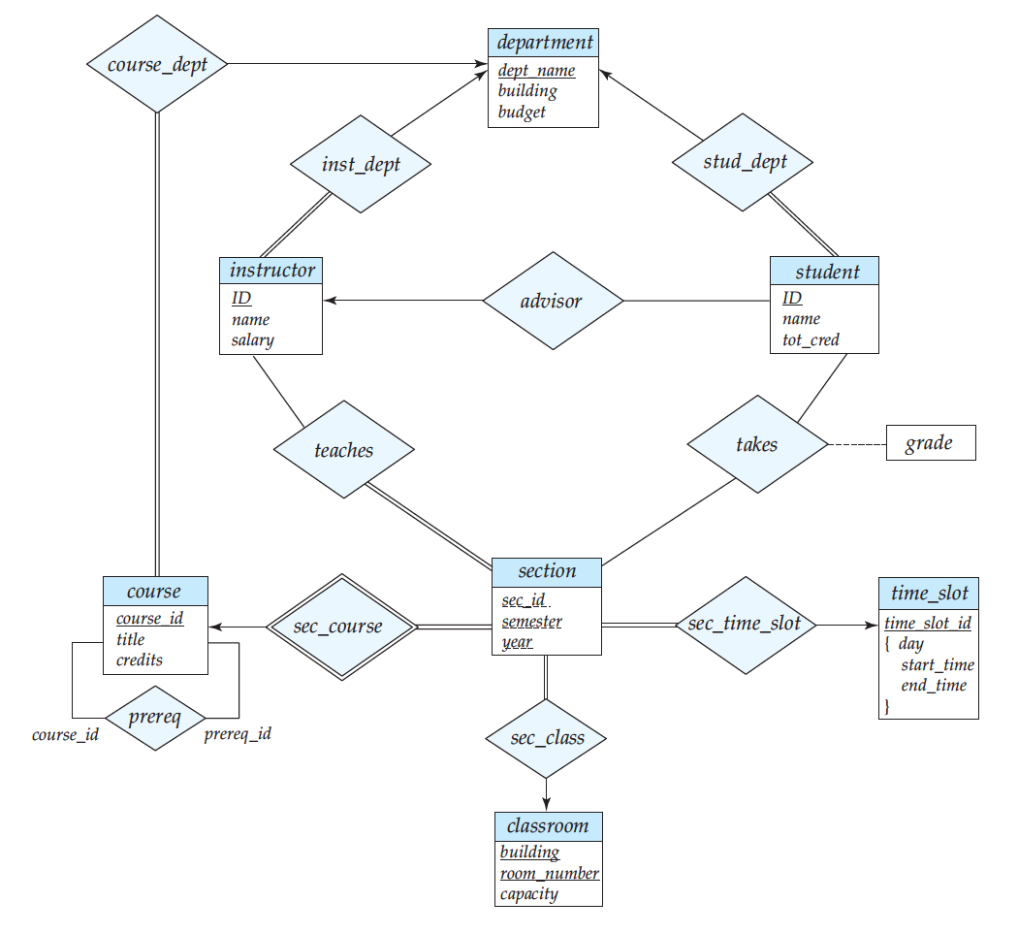
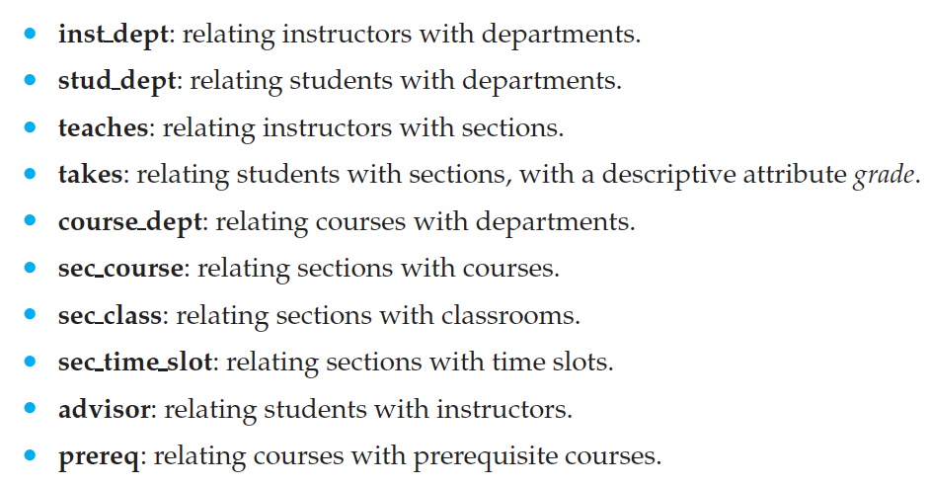
E-R Diagram for a University Enterprise

Slide 46
Reduction to Relation Schemas

Slide 47
Reduction to Relation Schemas
Entity sets and relationship sets can be expressed uniformly as relation schemas that represent the contents of the database.
A database which conforms to an E-R diagram can be represented by a collection of schemas.
For each entity set and relationship set there is a unique schema that is assigned the name of the corresponding entity set or relationship set.
Each schema has a number of columns (generally corresponding to attributes), which have unique names.

Slide 48
Representing Entity Sets
A strong entity set reduces to a schema with the same attributes student(ID, name, tot_cred)
A weak entity set becomes a table that includes a column for the primary key of the identifying strong entity set
section ( course_id, sec_id, sem, year )

Slide 49
Representation of Entity Sets with Composite Attributes
Composite attributes are flattened out by creating a separate attribute for each component attribute
Example: given entity set instructor with composite attribute name with component attributes first_name and last_name the schema corresponding to the entity set has two attributes name_first_name and name_last_name
Prefix omitted if there is no ambiguity (name_first_name could be first_name)
Ignoring multivalued attributes, extended instructor schema is
instructor(ID, first_name, middle_initial, last_name, street_number, street_name, apt_number, city, state, zip_code, date_of_birth)
Notes:
49

Slide 50
Representation of Entity Sets with Multivalued Attributes
A multivalued attribute M of an entity E is represented by a separate schema EM
Schema EM has attributes corresponding to the primary key of E and an attribute corresponding to multivalued attribute M
Example: Multivalued attribute phone_number of instructor is represented by a schema: inst_phone= ( ID, phone_number)
Each value of the multivalued attribute maps to a separate tuple of the relation on schema EM
For example, an instructor entity with primary key 22222 and phone numbers 456-7890 and 123-4567 maps to two tuples: (22222, 456-7890) and (22222, 123-4567)
Notes:
50

Slide 51
Representing Relationship Sets
A many-to-many relationship set is represented as a schema with attributes for the primary keys of the two participating entity sets, and any descriptive attributes of the relationship set.
Example: schema for relationship set advisor
advisor = (s_id, i_id)

Slide 52
Redundancy of Schemas
Many-to-one and one-to-many relationship sets that are total on the many-side can be represented by adding an extra attribute to the “many” side, containing the primary key of the “one” side
Example: Instead of creating a schema for relationship set inst_dept, add an attribute dept_name to the schema arising from entity set instructor

Slide 53
Redundancy of Schemas (Cont.)
For one-to-one relationship sets, either side can be chosen to act as the “many” side
That is, an extra attribute can be added to either of the tables corresponding to the two entity sets
If participation is partial on the “many” side, replacing a schema by an extra attribute in the schema corresponding to the “many” side could result in null values
Notes:
53

Slide 54
Redundancy of Schemas (Cont.)
The schema corresponding to a relationship set linking a weak entity set to its identifying strong entity set is redundant.
Example: The section schema already contains the attributes that would appear in the sec_course schema
Notes:
54

